Slide 1

MARKET TREND ANALYSIS USING MACHINE LEARNING
Om Jaju (20311A1901)
Y Vishal (20311A1904)
G Sai Phaneendra (20311A1958)

Slide 2
ABSTRACT
In this project we attempt to implement machine learning approach to predict stock prices. Machine learning is effectively implemented in forecasting stock prices. The objective is to predict the stock prices in order to make more informed and accurate investment decisions. We propose a stock price prediction system that integrates mathematical functions, machine learning, and other external factors for the purpose of achieving better stock prediction accuracy and issuing profitable trades.

Slide 3

INTRODUCTION
This project focuses on the use of Regression and LSTM based Machine learning to predict stock values. LSTMs are very powerful in sequence prediction problems because they’re able to store past information. This is important in our case because the previous price of a stock is crucial in predicting its future price. While predicting the actual price of a stock is an uphill climb, we can build a model that will predict whether the price will go up or down.

Slide 4
LSTM MODEL
LSTM models are a subtype of Recurrent Neural Networks. They are used to recognize patterns in data sequences, such as those that appear in sensor data, stock prices, or natural language. A special architecture allows the LSTM model to decide whether to retain previous information in short-term memory or discard it.
RNN : A recurrent neural network is a type of artificial neural network commonly used in speech recognition and natural language processing. Recurrent neural networks recognize data's sequential characteristics and use patterns to predict the next likely scenario.

Slide 5
LITERATURE SURVEY
Stock Market Prediction Using Machine Learning Techniques, The Stock Market Prices play a crucial role in today’s economy. Researchers have discovered that social media platforms such as twitter and web news tend to influence the decision making process of any individual.
Stock market prediction seems like a complicated problem because there are various factors that are still left unaddressed and do not seem to be statistical at first. But to our rescue there are various machine learning algorithms by using which we could efficiently predict current trends in the stock market by using the references from the previous data.

Slide 6
EXISTING METHODOLOGY
We find that the existing stock selection methods mainly include analytic hierarchy process (AHP), fuzzy analysis, data envelopment analysis (DEA), genetic algorithm, clustering, support vector machine (SVM). Some of them are:
1.Principal Component Analysis (PCA): PCA is a statistical analysis method that reduces multiple variables to a few principal components by dimension reduction technology.
2.Clustering Analysis: Clustering analysis is to group data objects according to the information that describes the objects and their relationships found in the data.

Slide 7
CONTINUATION…
3.Support Vector Machine (SVM): SVM is a generalized linear classifier that classifies data according to supervised learning. Its decision boundary is the maximum margin hyperplane to solve the learning samples.
4.Mean Regression: Mean regression means that the stock price always fluctuates around its value centre in the long run. Specifically, the stock price will fluctuate to its value centre, whether it is higher than or lower than its value centre in the short term.

Slide 8
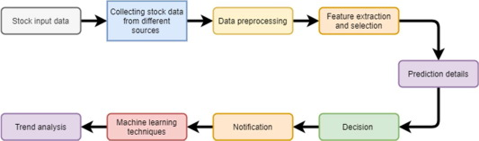
STEP BY STEP PROCEDURE

Slide 9
PROPOSED METHODOLOGY
Long short-term memory network (LSTM) is a particular form of recurrent neural network (RNN).
Working of LSTM:
LSTM is a special network structure with three “gate” structures.
Three gates are placed in an LSTM unit, called input gate, forgetting gate and output gate. While information enters the LSTM’s network, it can be selected by rules. Only the information conforms to the algorithm will be left, and the information that does not conform will be forgotten through the forgetting gate.
1) Input gate-Decides how much information from current input flows to the cell state.
2) Forget gate - Decides how much information from the current input and the previous cell state flows into the current cell state.
3) Output gate - Decides how much information from the current cell state flows into the hidden state, so that if needed LSTM can only pick the long-term memories or short-term memories and long-term memories.

Slide 10
LSTM MODEL SYNTAX
from keras.models import Sequential
from keras.layers import LSTM, Dense
model = Sequential()
model.add(LSTM(units=100, return_sequences=True, input_shape=(timesteps, input_dim)))
model.add(Dense(units=1))
model.compile(optimizer='adam', loss='mean_squared_error')

Slide 11
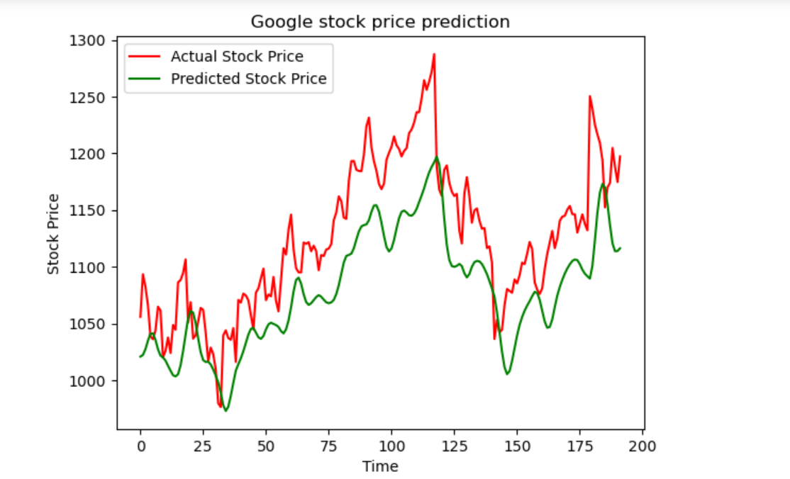
RESULTS

Slide 12
CONCLUSION
The goal of this work was to investigate LSTM models for stock price prediction. Despite the fact that after examining the primary influencing elements and combining social reviews connected to stock, reliable stock prediction is still difficult to achieve. It is not feasible to set a price. However, certain strategies have been successful in obtaining a near approximation. For time series prediction of stock prices majorly LSTMs are used for their long term dependencies.
There are still a lot of models that can be used and improved upon.Some models are more effective with historical data, while others are more effective with sentiment data.

Slide 13
REFERENCES
https://www.researchgate.net/publication/341482418_A_Survey_on_Stock_Market_Prediction_Using_Machine_Learning_Techniques
https://en.wikipedia.org/wiki/Long_short-term_memory
https://www.kaggle.com/code/faressayah/stock-market-analysis-prediction-using-lstm
https://en.wikipedia.org/wiki/Stock_market

Slide 14


